Slide 1
Intuilize QB Weekly Meeting
1/17/2025

Slide 2
Agenda
Introductions
Status of NDA
Discuss previous team's progress
Discuss what is expected of us
Obtaining data

Slide 3
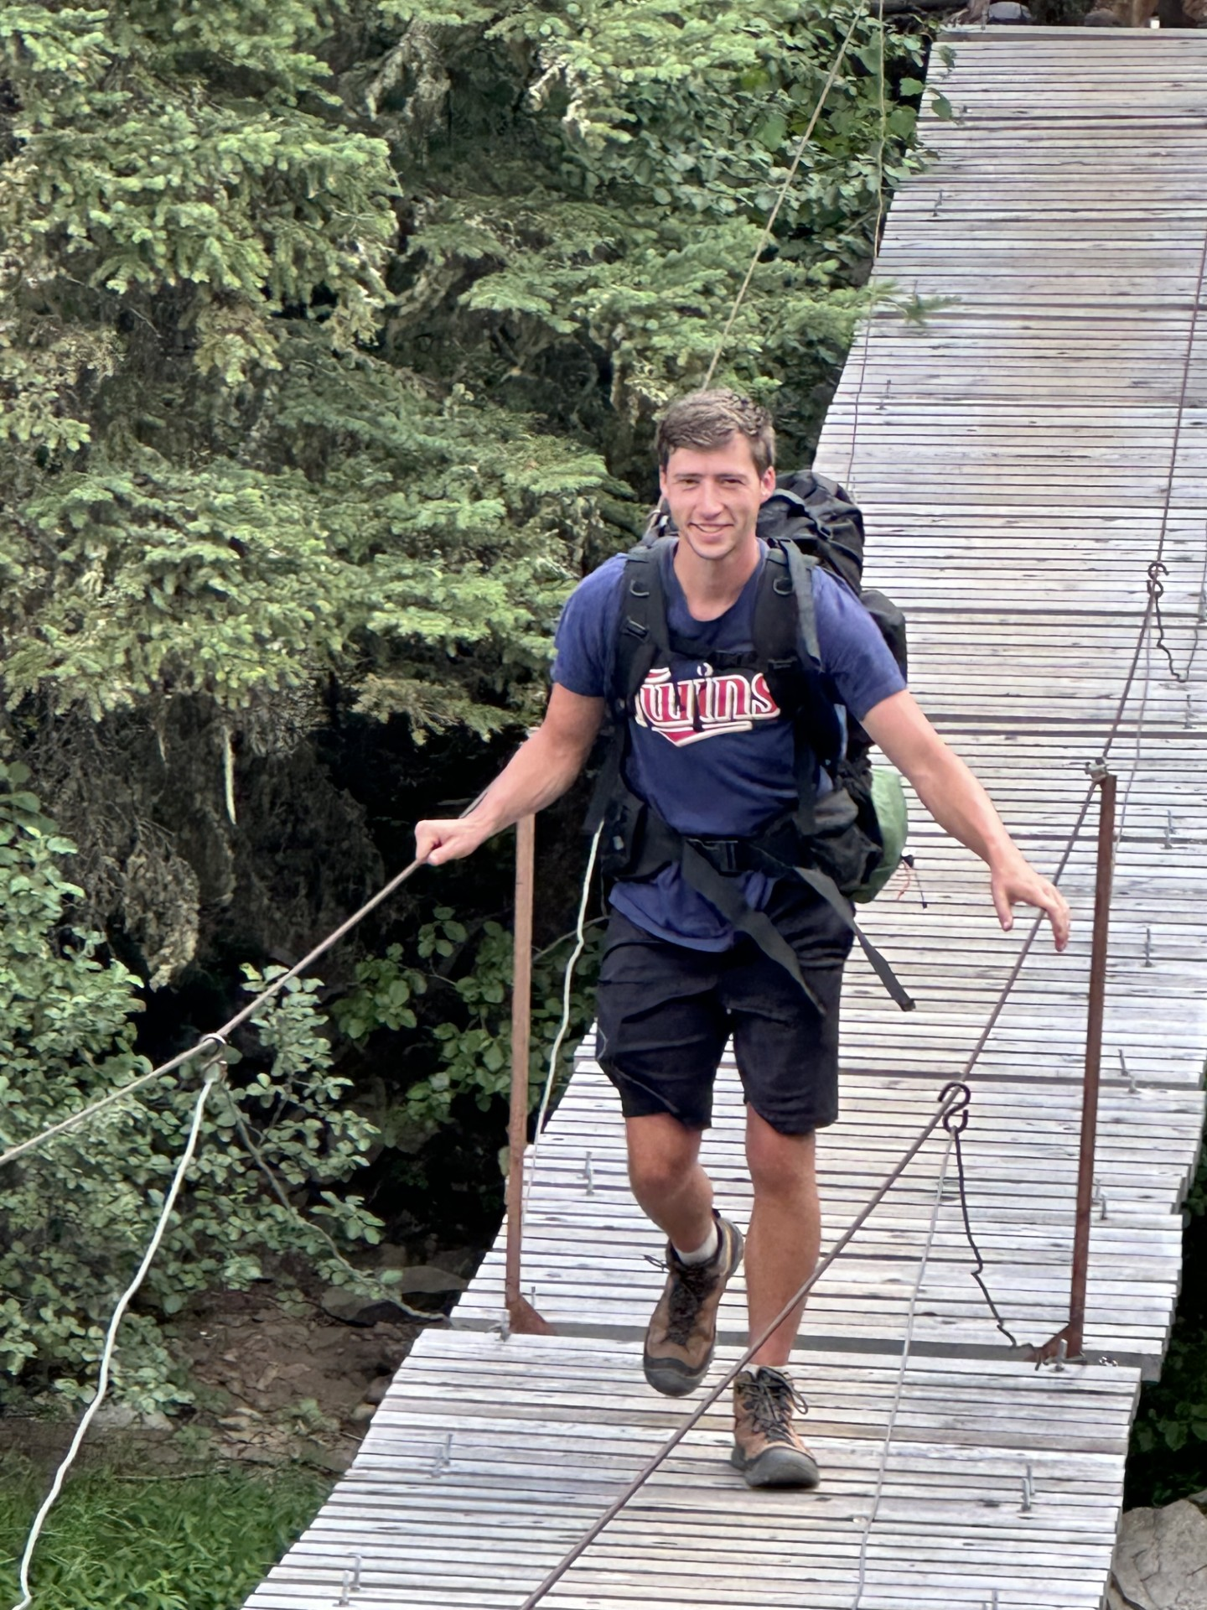
Andy Hjulberg
Team Lead
S2 Student
From Blaine, MN
Hobbies:
Music/Playing guitar
Sports
Hiking and nature
Some previous experience with machine learning models

Slide 4
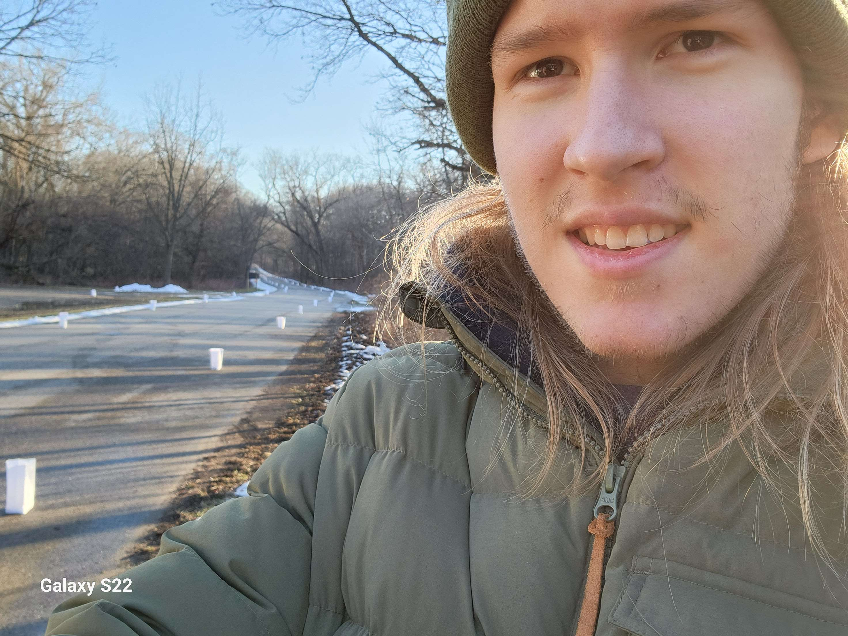
Graham Wilkins Machine Learning Engineer
S2 Student
Interests in logic & problem solving
In my free time:
Games
Walks & nature
Family
Used CNNs & DL for a previous project
11/13/24 - 3

Slide 5
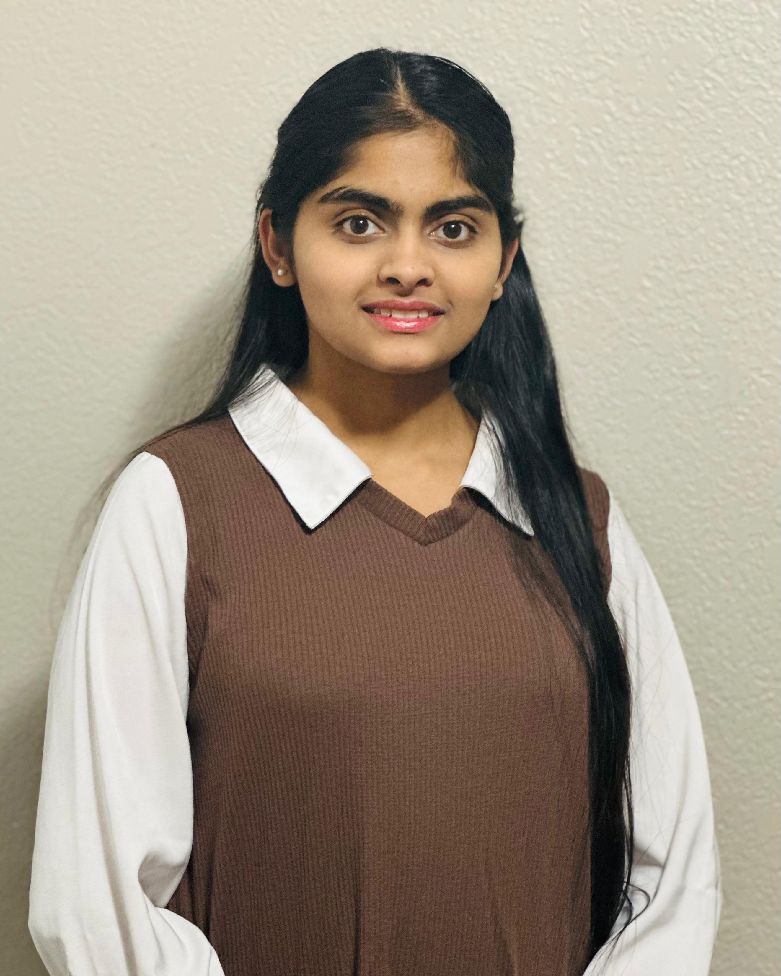
Sai Keertana Lakku Data Science Engineer
J2 Student
From Andhra, India
Hobbies:
Hiking
Travelling
No Prior Experience in ML but knowledgeable in Python.

Slide 6
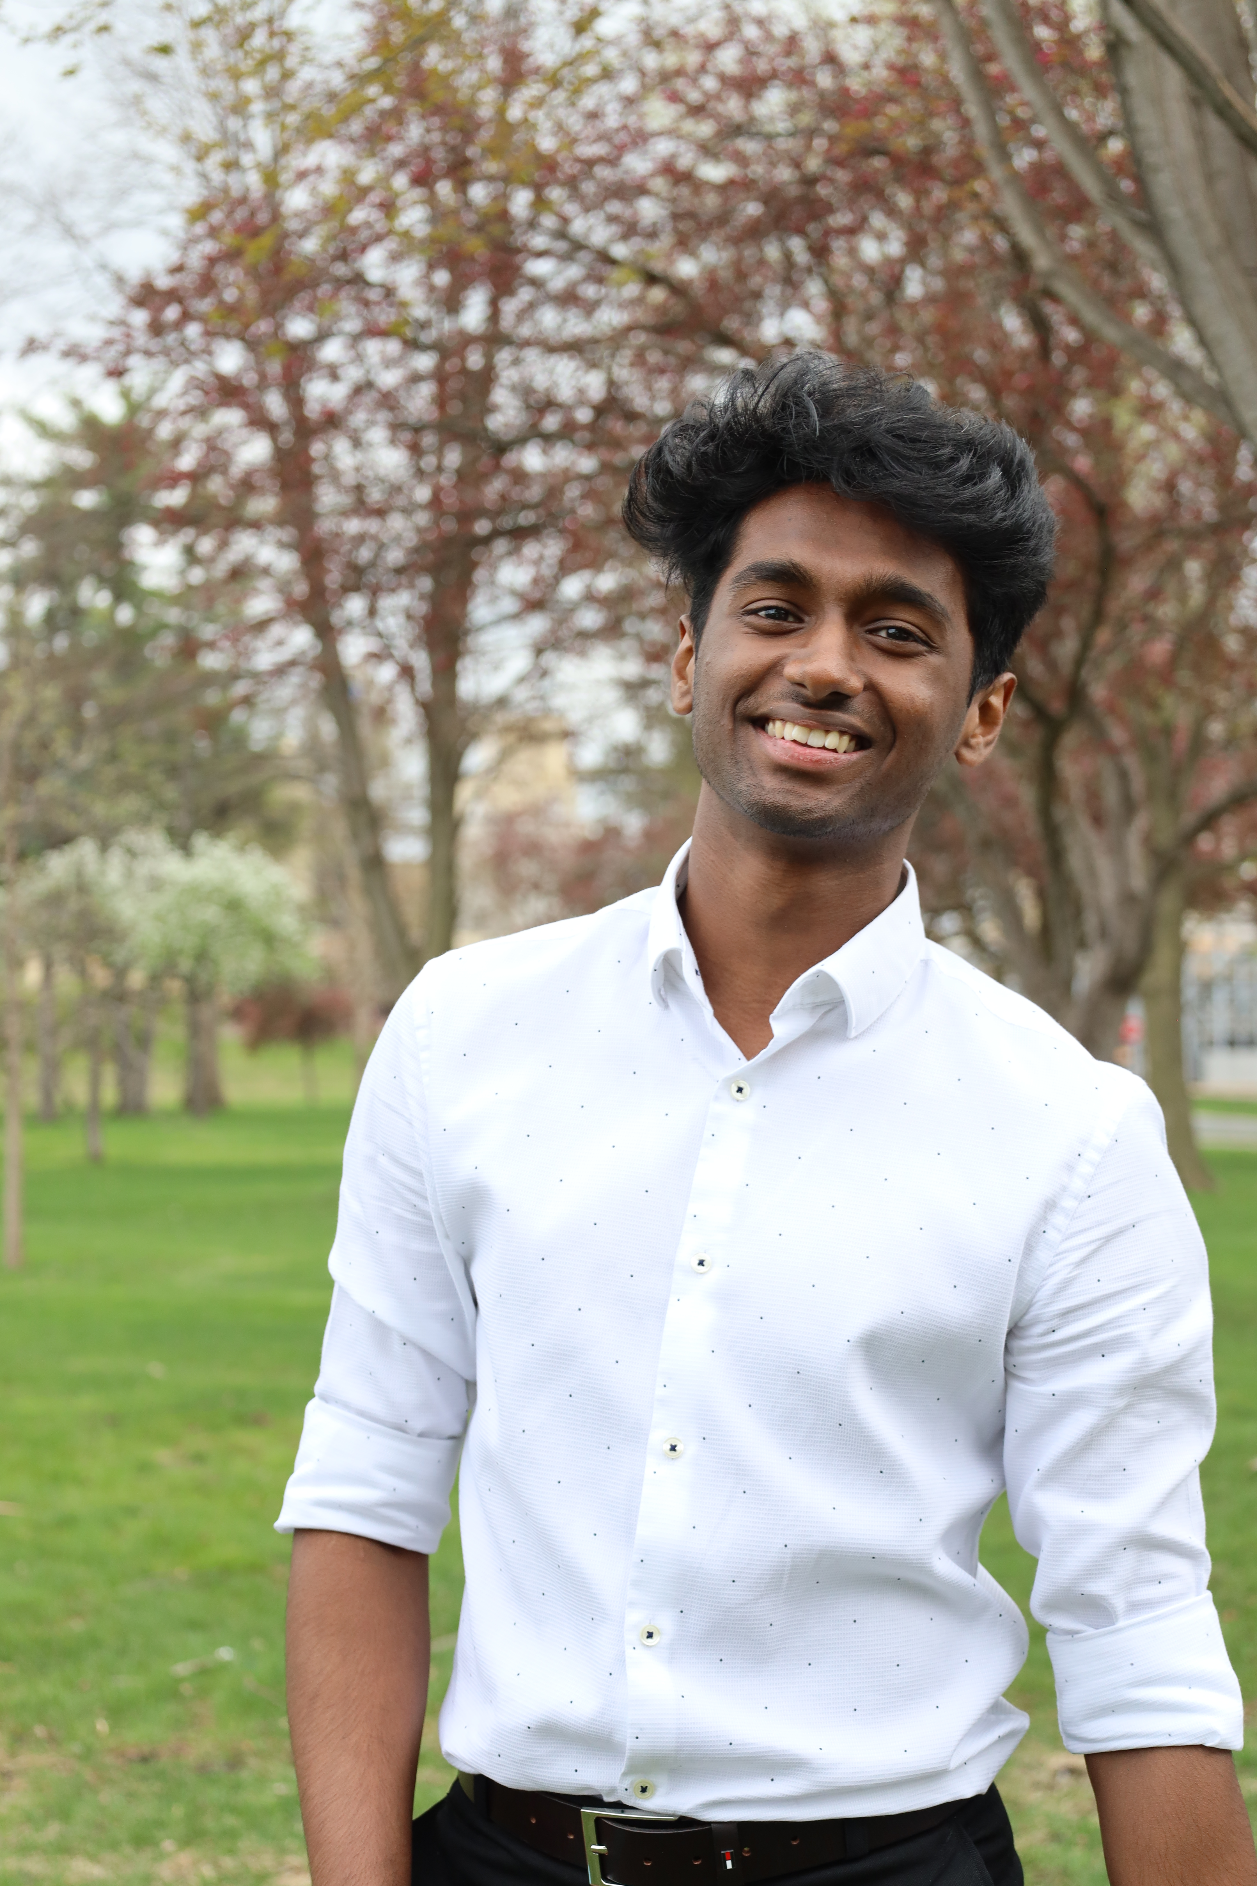
Shashank Reddy
Machine Learning Engineer
J2 Student
From Bangalore, India
Love to learn and challenge myself and play sports
Peak Curiosity
Worked on Winforms application for Navitor
Some experience in supervised Machine Learning and CNN.

Slide 7
Questions
Status of NDA document.
What was the previous team able to accomplish?
How would you like us to build off what has already been completed?
When can we expect to get data?
What tools will we be using?

